Slide 1

Notes:
Welcome everyone.
Introduction to me.

Slide 2
The Maths Behind
Machine Learning
Notes:
My introduction to ML.
Data analytics world getting more interested in ML.
Noticed a trend.
Black box
A shame
Need to understand to effectively use.
More frustration.
Missing fun.
Things I want to put right today.
To show how quick, 3 algorithms.
3 popular, used before, use again.

Slide 3

Notes:
Quick overview – classic classification problem.
Variables & class.

Slide 4
Classification
height
weight
Notes:
Supervised – we know if it’s dog or cat.

Slide 5
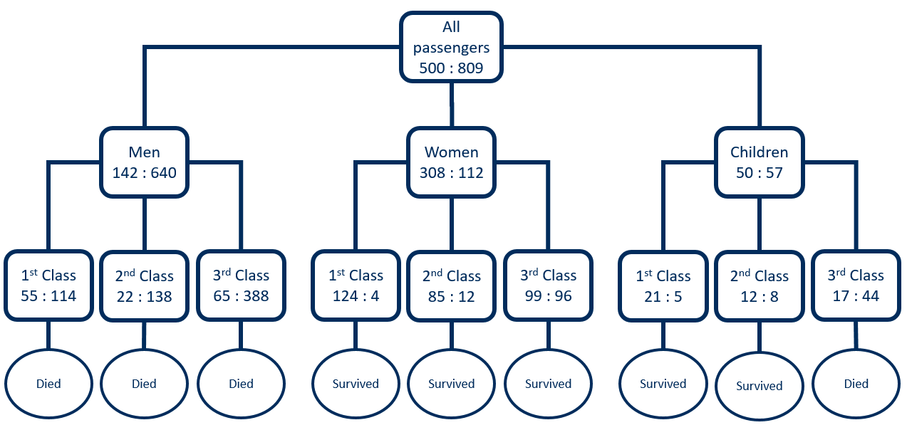
Decision Tree
Classification
Notes:
Widely used, popular, easy to understand.

Slide 6
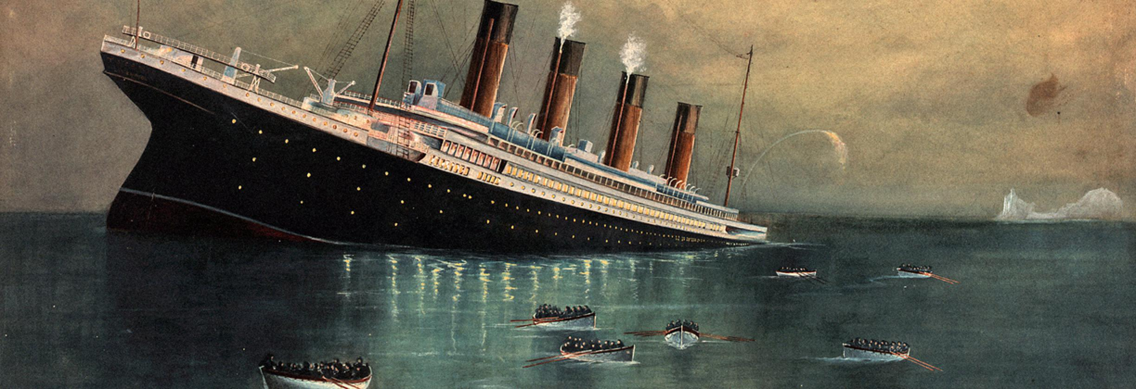
Would I have survived?

Slide 7
All passengers
500 : 809
Died

Slide 8
All passengers
500 : 809
Men
142 : 640
Women
308 : 112
Children
50 : 57
Died
Survived
Died

Slide 9
All passengers
500 : 809
Men
142 : 640
Women
308 : 112
Children
50 : 57
1st Class
55 : 114
2nd Class
22 : 138
3rd Class
65 : 388
1st Class
124 : 4
2nd Class
85 : 12
3rd Class
99 : 96
1st Class
21 : 5
2nd Class
12 : 8
3rd Class
17 : 44
Died
Died
Died
Survived
Survived
Survived
Survived
Survived
Died

Slide 10
All passengers
500 : 809
Men
142 : 640
Women
308 : 112
Children
50 : 57
1st Class
55 : 114
2nd Class
22 : 138
3rd Class
65 : 388
1st Class
124 : 4
2nd Class
85 : 12
3rd Class
99 : 96
1st Class
21 : 5
2nd Class
12 : 8
3rd Class
17 : 44
Died
Died
Died
Survived
Survived
Survived
Survived
Survived
Died
14%

Slide 11
Classification
Demo

Slide 12
pclass
age
name
cabin
fare
boat
body
Which variable do we split on?
The best variable
parch
ticket
survived
embarked
home.dest
sex
sibsp

Slide 13
pclass
age
name
cabin
fare
boat
body
The best variable
parch
ticket
survived
embarked
home.dest
sex
sibsp

Slide 14

The Gini Index
$$Gini=1−\sum_{i=1}^{C}{{(p_{i})}^{2}}$$
Notes:
Gini index originally used to calculate income inequality.
Derived 1912 – present.
Low Gini index is desired.

Slide 15

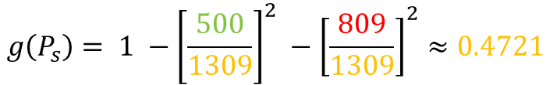

$$g\left(P_{s}\right)= 1 −{\left[\frac{500}{1309}\right]}^{2} −{\left[\frac{809}{1309}\right]}^{2}≈0.4721$$
$$g\left(P_{m}\right)= 1 −{\left[\frac{161}{843}\right]}^{2} −{\left[\frac{682}{843}\right]}^{2}≈0.3090$$
$$g\left(P_{f}\right)= 1 −{\left[\frac{339}{466}\right]}^{2} −{\left[\frac{127}{466}\right]}^{2}≈0.3965$$
$$G=0.4721 −\left(\frac{843}{1309} ×0.3090\right)−\left(\frac{466}{1309} ×0.3965\right) ≈0.132$$

Slide 16
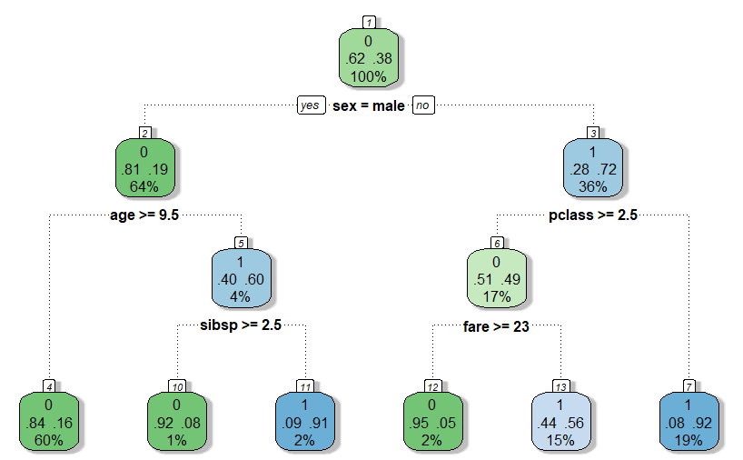
sex = male
sex = 0.132
sex = female
fare
pclass
sibsp
parch
age
embarked
age
pclass
fare
parch
embarked
sibsp
pclass
fare
sibsp
embarked
parch
age

Slide 17
pclass
1 2 3
1.5 2.5
Notes:
Continue recursively, until sub group reaches min size, or no improvement.
Greedy.
Cross validation performed to trim.

Slide 18

Notes:
Used a lot in data analytics.
Similar to classification.

Slide 19
Regression
profit
time

Slide 20
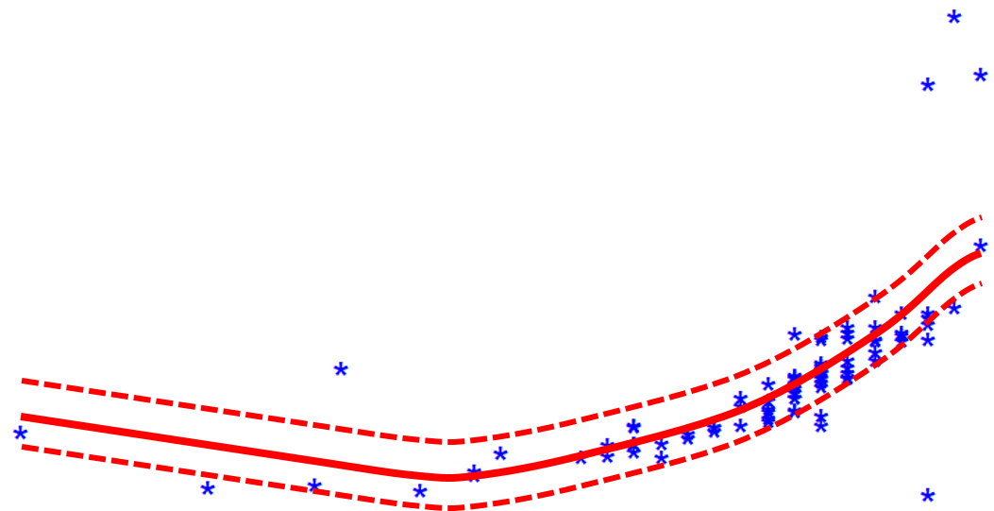
Support Vector
Regression
Notes:
SVR similar to SVM, getting more popular.
Works well with non-linear.

Slide 21
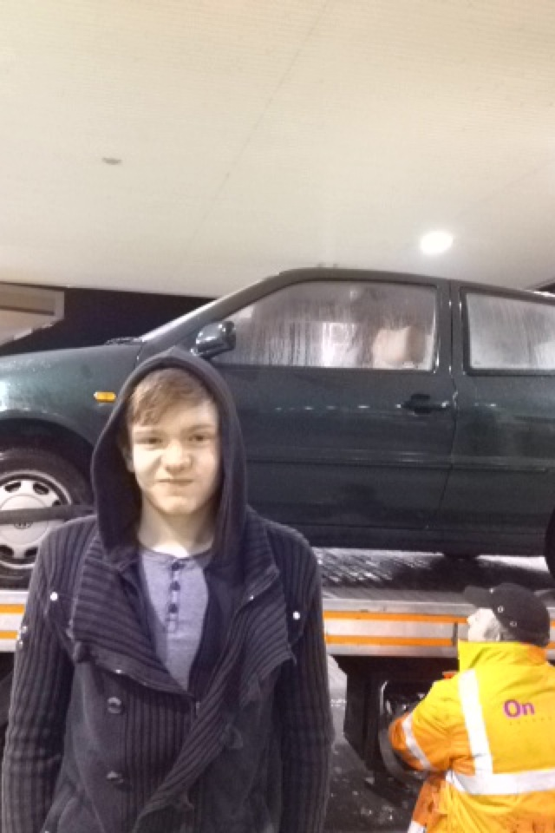
How much is
my car worth?

Slide 22
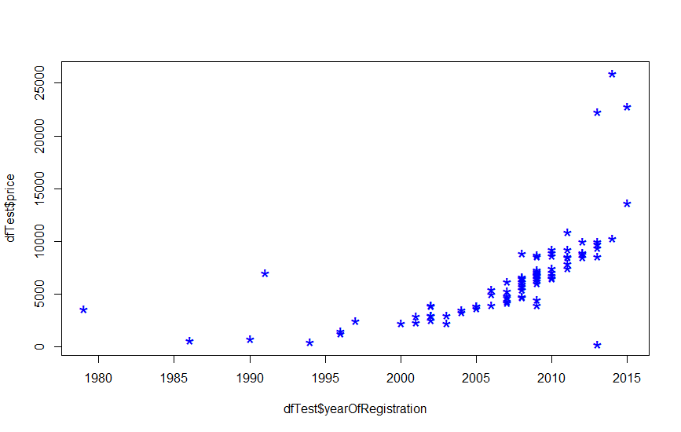
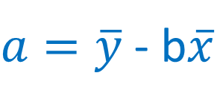


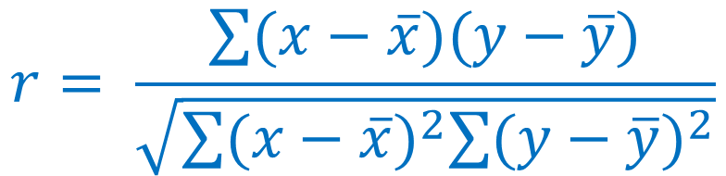
15,000-
$$y=a+bx$$
$$r= \frac{\sum{(x−\overline{x})(y−\overline{y})}}{\sqrt{\sum{{(x−\overline{x})}^{2}\sum{{(y−\overline{y})}^{2}}}}}$$
$a=\overline{y}$ - b$\overline{x}$
$$b=r \frac{σ_{y}}{σ_{x}}$$
price (€)
0 -
|
1980
|
2015
year
Notes:
Uses a Kernel function, this case Radial Basis function Kernel.

Slide 23
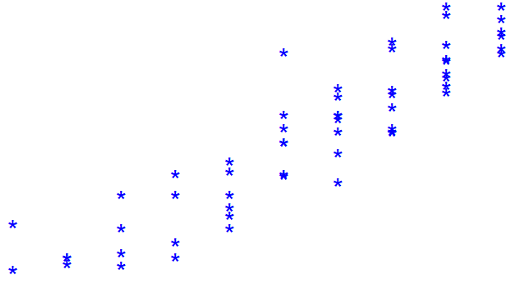
10,000-
15,000-
price (€)
3,000 -
0 -
|
2003
|
1980
|
2011
|
2015
year

Slide 24
15,000-
price (€)
0 -
|
1980
|
2015
year

Slide 25


15,000-
price (€)
$$f\left(x\right)+ ε$$
$$f\left(x\right)− ε$$
0 -
|
1980
|
2015
year
Notes:
Outside margin points penalised.
Principle of maximal margin.
Important to prevent overfitting.

Slide 26



Slide 27
Regression
Demo

Slide 28
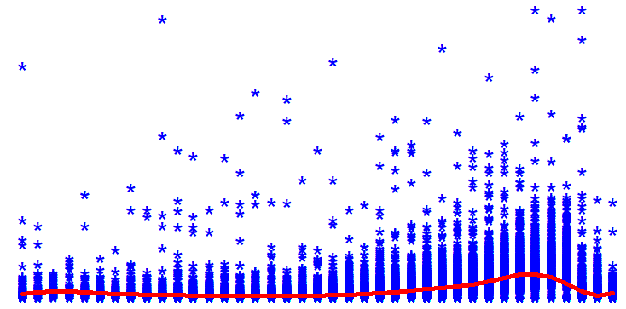
200,000-
price (€)
0 -
|
1980
|
2015
year

Slide 29
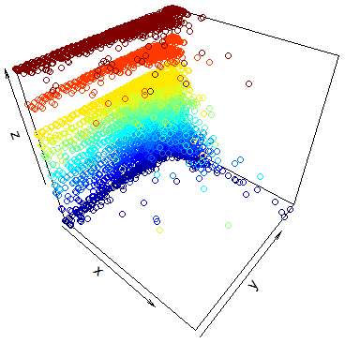
…and so on
sixth
third
forth
fifth
A third dimension

Slide 30

Notes:
Netflix clustering. Similar to HBO.

Slide 31
Clustering

Slide 32
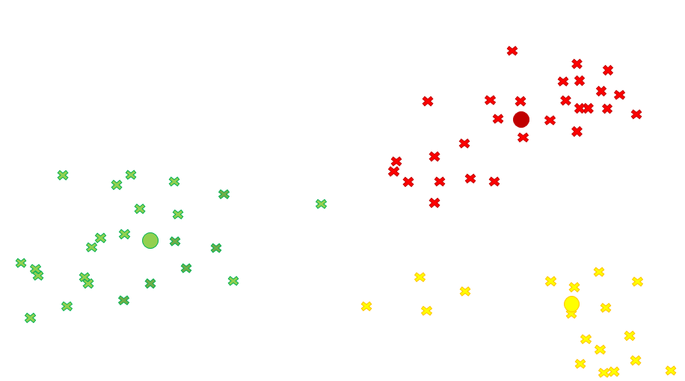
K-Means
Clustering
Notes:
K-Means – most popular, released decades ago, improvements.

Slide 33

What new music
can I discover?

Slide 35

Euclidean distance$= \sqrt{{(x_{2}−x_{1})}^{2}+{(y_{2}−y_{1})}^{2}}$

Slide 55
Clustering
Demo
Notes:
Better algorithms for problem: Gaussian mixture models, hierarchical clustering.

Slide 56
Notes:
We’ve gone through 3 algorithms in 1 hour.
List of good sources…

Slide 57
alex.smola.org/papers/2004/SmoSch04.pdf
www.listendata.com
www.kdnuggets.com
data-flair.training/blogs
www.analyticsvidhya.com
cowlet.org
github.com/matt-willis
hackernoon.com
r4ds.had.co.nz
towardsdatascience.com
blogs.adatis.co.uk
archive.ics.uci.edu/ml/datasets.html
www.r-bloggers.com
www.datacamp.com
elitedatascience.com
www.datasciencecentral.com
kernelsvm.tripod.com
trevorstephens.com
www.coursera.org
www.learnbymarketing.com
wiki.icub.org/images/8/82/OnlineSVR_Thesis.pdf

Slide 58
matt.willis@adatis.bg
Notes:
I hope you’ve learnt something.
More importantly, changed your approach.

